Slide 1
Lecture 6. Convolutional neural network
AI in Genetics
ZOO6927 / BOT6935 / ZOO4926

Slide 2
1. CNN intuitions

Slide 3
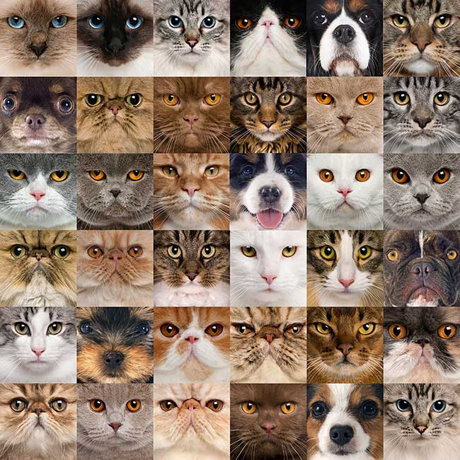
Image data is unstructured
Notes:
Unlike structured data, images don't follow any specific pattern. It’s impossible to say, for example, that the third line will always contain the eye of an animal or that the bottom left corner will always represent a round-shaped object. Images can be anything and don't follow any structure. That’s why images are unstructured data.
However, images do contain features. They contain different shapes (lines, circles, rectangles…), colors (red, blue, orange, yellow…), and specific characteristics related to different types of objects (hair, wheel, leaves, and so on). Our eyes and brain quickly analyze and interpret all these features to identify objects in images. Thus, we need to simulate the same analytical process in code. This is where image filters (also called kernels) come into play. Image filters are small matrices (tensors) specialized in detecting a specific pattern. For example, one filter might detect vertical lines while another detects horizontal lines.

Slide 4
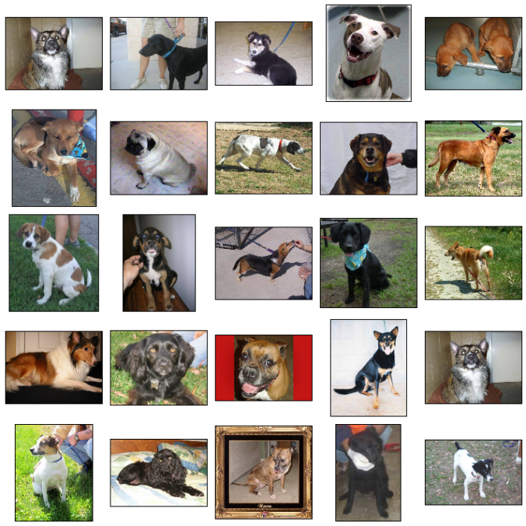
Image data is unstructured
Notes:
Unlike structured data, images don't follow any specific pattern. It’s impossible to say, for example, that the third line will always contain the eye of an animal or that the bottom left corner will always represent a round-shaped object. Images can be anything and don't follow any structure. That’s why images are unstructured data.
However, images do contain features. They contain different shapes (lines, circles, rectangles…), colors (red, blue, orange, yellow…), and specific characteristics related to different types of objects (hair, wheel, leaves, and so on). Our eyes and brain quickly analyze and interpret all these features to identify objects in images. Thus, we need to simulate the same analytical process in code. This is where image filters (also called kernels) come into play. Image filters are small matrices (tensors) specialized in detecting a specific pattern. For example, one filter might detect vertical lines while another detects horizontal lines.

Slide 5
Images do contain features

Slide 6
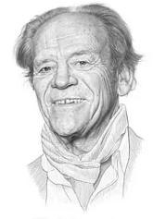
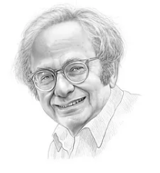

Torsten Wiesel David Hubel
Source: Krohn, J. (2020). Deep Learning Illustrated. New York, NY: Addison-Wesley. (Chapter 1)
Notes:
Let’s begin with a quick review of the research on the workings of the human eye. Interestingly, eye research began decades ago. David H. Hubel and Torsten Wiesel performed a series of experiments on cats in 1958 and 1959, followed shortly thereafter with experiments on monkeys. This research provided crucial insights into the structure of the visual cortex. The authors received the Nobel Prize in Physiology or Medicine in 1981 for this work.
Image Source: https://towardsdatascience.com/towards-geometric-deep-learning-iii-first-geometric-architectures-d1578f4ade1f
=====
David H. Hubel & Torsten Wiesel (key names in vision research)
Visual cortex research / experiments on cats 1958 / 1959 – later monkeys.
Nobel Prize in Medicine (1981)

Slide 7
Source: Geron, A. (2019). Hands-on machine learning with Sci-Kit learn, Keras, & Tensorflow. Sebastopol, CA: O’Reilly Media. (Chapter 14)
Notes:
One of Hubel and Wiesel’s key discoveries was that many neurons in the visual cortex have a small local receptive field. In other words, some neurons only react to visual stimuli located in a narrow region of the visual field. Here the local receptive fields of five neurons are shown as dashed circles.
Additionally, the receptive fields of different neurons may overlap. But taken together, they tile the entire visual field. Hubel and Wiesel also discovered that some neurons have larger receptive fields, reacting to more complex patterns or combinations of lower-level patterns.
All this led to the idea that higher level neurons receive input from lower-level collaborators. As shown here, the neurons in the second layer are only connected to a few neurons in the first layer. This is called a sparse network. Even so, those connections allow second layer neurons to detect more complex shapes, including triangles, x’s, and so on. The beauty of this architecture lies in its ability to detect all sorts of complex patterns in any part of the visual field.

Slide 8
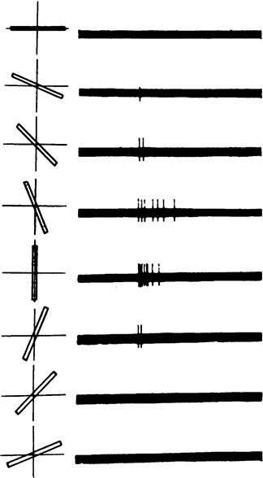
Source: Krohn, J. (2020). Deep Learning Illustrated. New York, NY: Addison-Wesley. (Chapter 1)
Notes:
Another discovery Hubel and Wiesel made is that some neurons only react to images of horizontal lines, while others react to lines with different orientations. Interestingly, two neurons may share the same receptive field, but each reacts to different line orientations. Neurons, in other words, specialize at detecting specific patterns.
Here we see a simple cell in the primary visual cortex of a cat firing at different rates, depending on the orientation of the line it sees.
=====
Additional information about Hubel and Wiesel’s research is provided in the BiologicalVision.pdf, located in our Practicum Teams workspace. Path: Files -> Textbooks

Slide 9
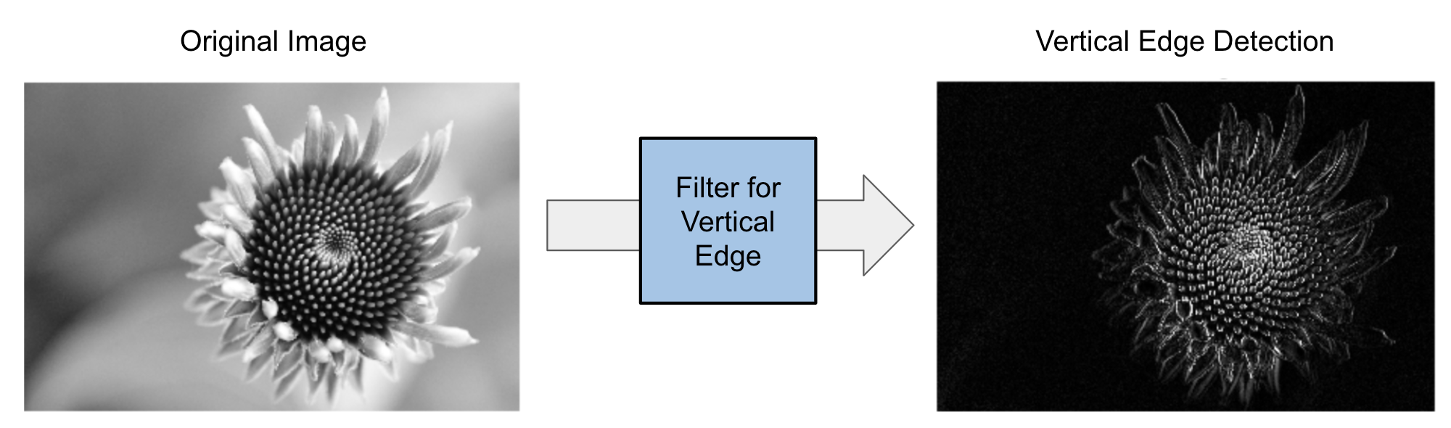
Original Image
Vertical Edge Detection
Filter for
Vertical
Edge
Source: Mirza, R.B. et al. (2021). The deep learning workshop. Birmingham, UK: Packt Publishing. (Chapter 3)
Notes:
So how do we mimic the eye’s ability to detect patterns in its visual field?
Computer vision systems run such filters over every part of an image, generating a new image with the detected patterns highlighted. These generated images are called feature maps. An example of a vertical edge detection feature map is shown on the right. Such filters such as Gaussian and Sharpen are widely used in image processing.
=====
So how do we mimic the eye’s ability to detect patterns in its visual field?
Images are unstructured data + features
Features include (lines, circles, rectangles, and so on), colors (red, blue, orange, yellow, and so on), and specific characteristics related to different types of objects (hair, wheel, leaves, and so on)
Our eyes automatically detect features – we mimic this ability with images filters, also called kernels.
Image filters (kernels) are small matrices (tensors) specialized in detecting a defined pattern.
Vertical lines
Horizontal lines
Computer vision systems run such filters on every part of the image, generating a new image with the detected patterns highlighted. These kinds of generated images are called feature maps.
Adobe Photoshop – Gaussian and Sharpen filters

Slide 10
Why do we need Convolutional Neural Networks?
Source: Geron, A. (2019). Hands-on machine learning with Sci-Kit learn, Keras, & Tensorflow. Sebastopol, CA: O’Reilly Media. (Chapter 14)
Notes:
So, why do we need a new kind of neural network? Why not use a deep neural network with fully connected layers for image recognition tasks?
Well, fully connected networks work fine for small images (e.g., MNIST), but they break down for larger images because of the huge number of parameters required. For example, a 100 × 100–pixel image has 10,000 pixels, and if the first layer has just 1,000 neurons, that adds up to 10 million connections. And that’s just the first layer! CNNs solve this problem through partially connected layers and the use of new kinds of layers.
=====
Why CNN’s – why not use fully connected neural networks?
Fully connected works well with small images (28 x 28 pixels – size of MNIST images), not so well with larger images.
A 100 × 100–pixel image has 10,000 pixels, and if the initial layer has just 1,000 neurons, this adds up to a total of 10 million connections. And that’s just the first layer. CNNs solve this problem through partially connected layers and the use of new kinds of layers.
=====
Source: Geron, A. (2019). Hands-on machine learning with Sci-Kit learn, Keras, & Tensorflow. Sebastopol, CA: O’Reilly Media. (Chapter 14).

Slide 11
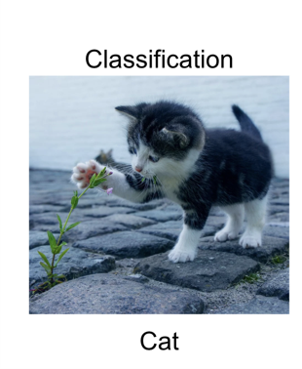
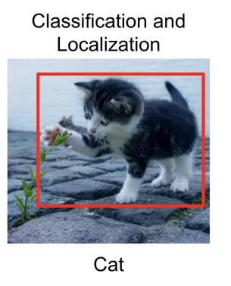
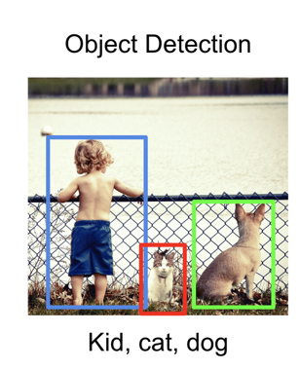
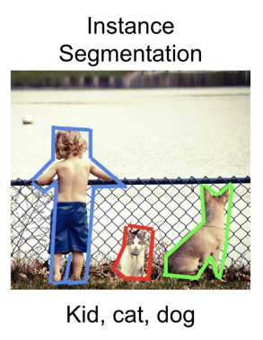
CNN Domains
Source: Mirza, R.B. et al. (2021). The deep learning workshop. Birmingham, UK: Packt Publishing. (Chapter 3)
Notes:
Convolutional neural networks have come a long way since they were first introduced. Today, many CNN models can process and interpret certain kinds of images faster and more accurately than humans. Computer vision can be split into four different domains:
Image classification, where we need to recognize the main object in an image.
Image classification and localization, where we need to recognize and localize the main object in an image with a bounding box.
Object detection, where we need to recognize multiple objects in an image with bounding boxes.
Image segmentation, where we need to identify the boundaries of objects in an image
=====
CNN performance has increased dramatically – some CNN models process and interpret images faster and more accurately than humans – Radiology example.
The four different domains:
Image classification, where we need to recognize the main object in an image.
Image classification and localization, where we need to recognize and localize the main object in an image with a bounding box.
Object detection, where we need to recognize multiple objects in an image with bounding boxes.
Image segmentation, where we need to identify the boundaries of objects in an image.

Slide 12
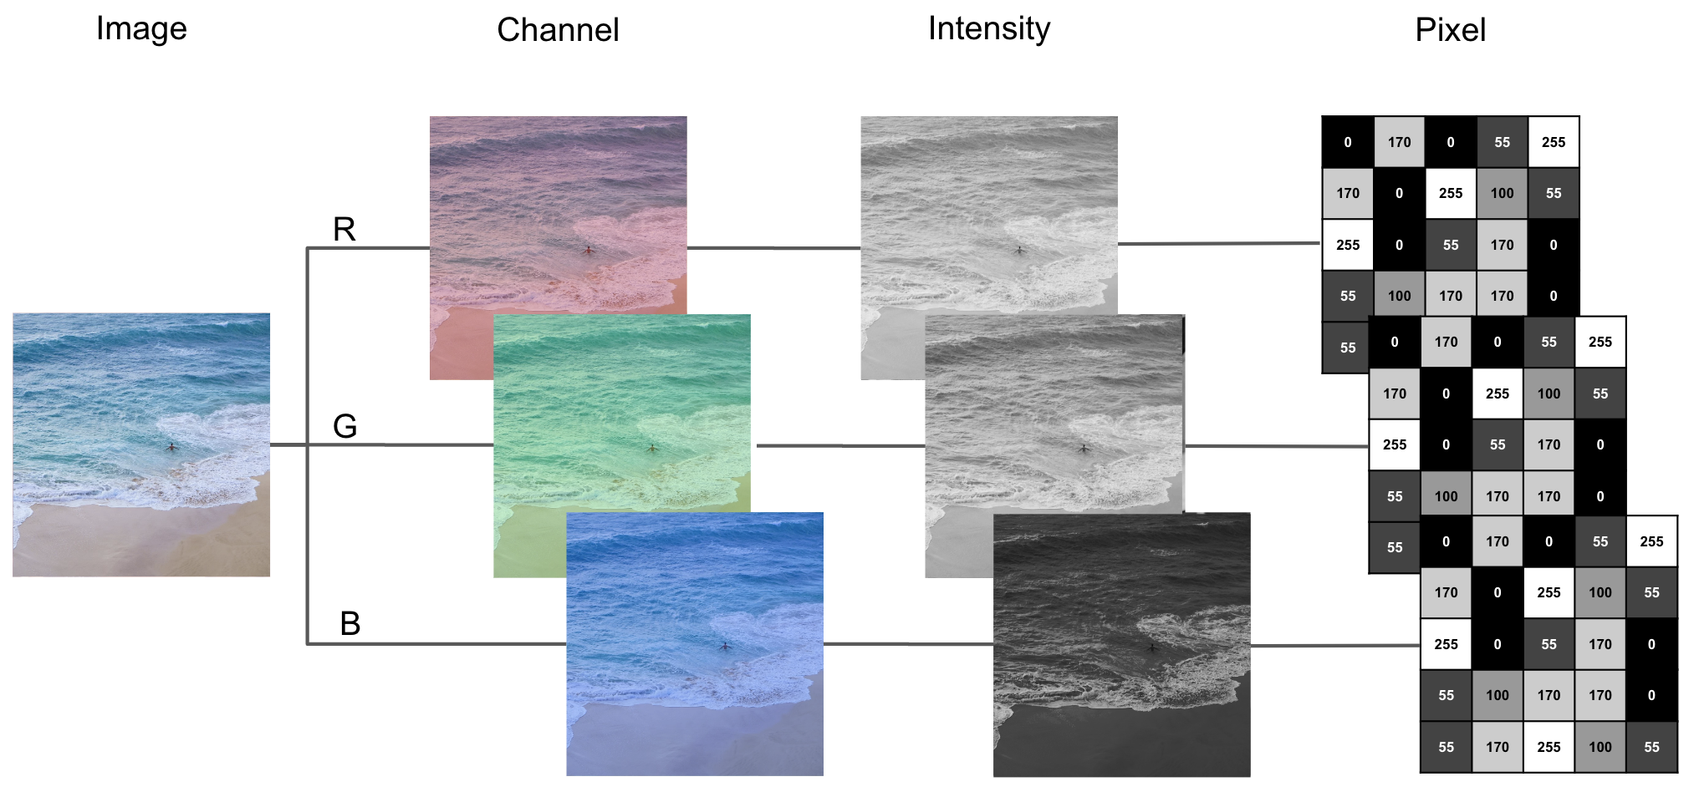
Source: Mirza, R.B. et al. (2021). The deep learning workshop. Birmingham, UK: Packt Publishing. (Chapter 3)
Notes:
Now eyes transform light into electrical signals that are then processed by the brain. But computers do not have physical eyes to capture light. They can only process digital data composed of bits (0’s or 1’s). So, to be able to “see", computers require a digitized version of an image.
A digital image is formed by a two-dimensional matrix of pixels. For a grayscale image, each pixel can take a value between 0 and 255, representing the intensity of grey at that point. Black and white images have a single channel while color images have three, one each for red, blue, and green.

Slide 13
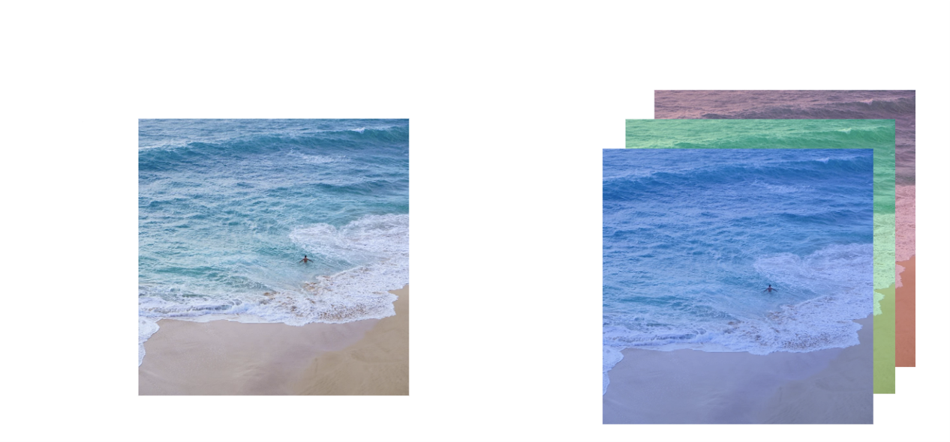
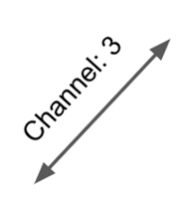
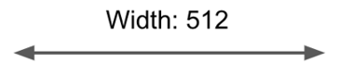
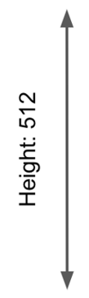
Source: Mirza, R.B. et al. (2021). The deep learning workshop. Birmingham, UK: Packt Publishing. (Chapter 3)
Notes:
A digital image is characterized by its dimensions (height, width, and channel):
Height: The number of pixels on the vertical axis.
Width: The number of pixels on the horizontal axis.
Channel: The number of channels. If there is only one channel, an image is grayscale. If there are three channels, the image is in color.

Slide 14

Google AI Glossary
https://developers.google.com/machine-learning/glossary
Notes:
The Google AI Glossary is a great resource for learning AI vocabulary. I encourage you to spend some time in it.
https://developers.google.com/machine-learning/glossary

Slide 15
2. CNN anatomy

Slide 16
Lesson Overview
Quick Review
Filters and Images
Convolution
Stride, Padding, Pooling

Slide 17
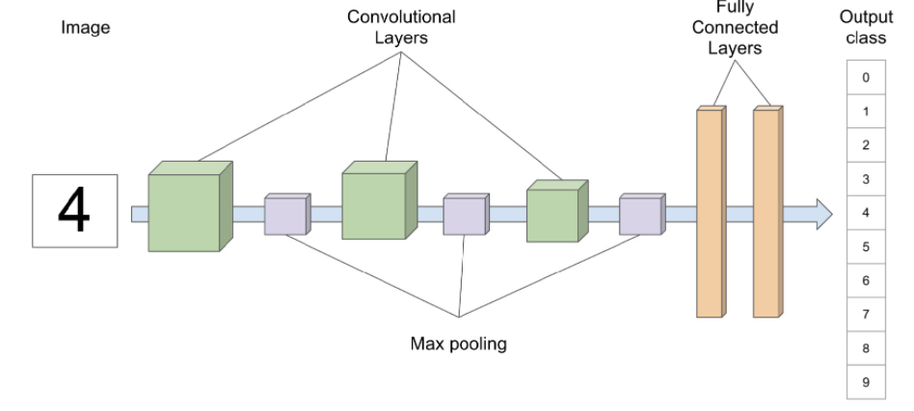
Notes:
In our Deep Learning Foundations series, we introduced the basic architecture of a multi-layered neural network. To frame this briefing, I begin with a picture of a convolutional neural network or CNN. The model pictured here recognizes and classifies handwritten digits from 0 to 9. There are three convolution layers in this model, each followed by a max pooling layer. The final layers are fully connected and are responsible for predicting the digit presented to the model. We already presented the architecture of these last two layers in our Foundations sequence. But the convolution and pooling layers are new, and we will discuss those shortly.
Let’s begin with a quick review of how images are constructed.
=====
Overview of a CNN
Model pictured here classifies handwritten digits – famous MNIST digits dataset – we already introduced you to this model in our last session.
Three convolution layers, followed by max pooling layers
Final two layers are fully connected – discussed in our beginner sequence.
Convolution and pooling layers are new
Many types and variations of layers – we just cover a few here.

Slide 18
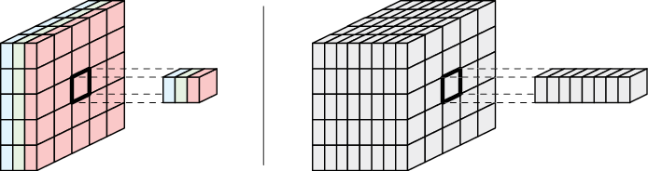
Source: Glassner, A. (2021). Deep learning: A visual approach. San Francisco, CA: No Starch Press. (Chapter 16)
Notes:
As noted in our introduction, images must be first converted to tensors before they can be “understood” by a CNN. On the left, a small color image has been converted to a tensor with 3 channels. Now if this had been a grayscale image, it would have had but one channel. As we see on the right, a tensor can have many channels. When that’s the case, the individual slices of a high-dimensional tensor are called elements.
=====
How do we present data to a CNN?
Left: When our tensor has one to three channels, we call each point a pixel
Right: For tensors with many channels, we call each slice through the channels an element

Slide 19
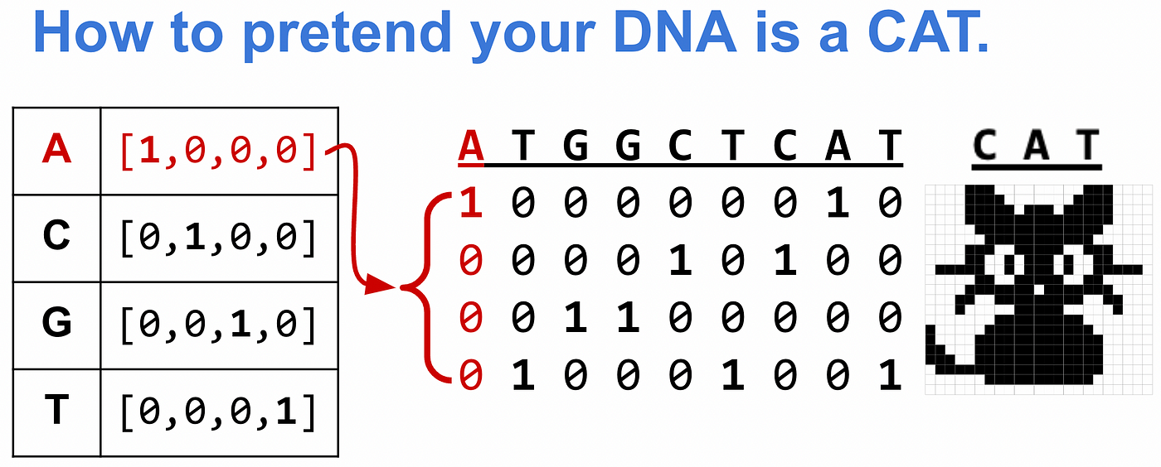

Slide 20
Simple filter for deteriming the yellowness of a pixel
+1
Pixel’s
red value
x
+1
Pixel’s
green value
x
+
-1
Pixel’s
blue value
x
Source: Glassner, A. (2021). Deep learning: A visual approach. San Francisco, CA: No Starch Press. (Chapter 16)
Notes:
At the heart of a CNN lies the convolution operation. To kick off our discussion of convolution, let’s consider how we might convert a color image to greyscale. More concretely, we want to create a grayscale image that has the same height and width as our color image, but where the amount of white in each pixel corresponds to the amount of yellow in its input pixel. And because our input is a color image, each pixel contains three numbers: one each for red, green, and blue.
To keep things simple, let’s assume that our RGB values range from 0 to 1. Thus, a pixel that’s pure yellow will have red and green values of 1, and a blue value of 0. As the red and green values decrease, or the blue value increases, the pixel’s color shifts away from yellow. Our goal, then, is to combine each input pixel’s three RGB values and then output a single number between 0 and 1 that represents how yellow it is.
As shown here, the +1, +1, and -1 boxes are weights – these are multiplied by each pixel value and then summed up by the net input (summation) function before being passed off to an activation function. This looks familiar, doesn’t it? Well, it is. It’s an artificial neuron.
=====
Let’s pretend we want to take a color image and create a greyscale image where the amount of white corresponds to yellow in the original.
Process a color image – each pixel in our image contains three numbers: one each for red, green, and blue
For simplicity, let’s assume our RGB values are from -1 to 1.
Pure yellow: red & green = 1, blue = 0
As red and green values decrease, or blue value increases, pixel’s color shifts away from yellow
We combine the three values to calculate the ‘yellowness’ of the pixel
As shown here, the +1, +1, and -1 boxes are weights – these are multiplied by each pixel value and then summed up by the net input (summation) function before being passed off to the activation function

Slide 21
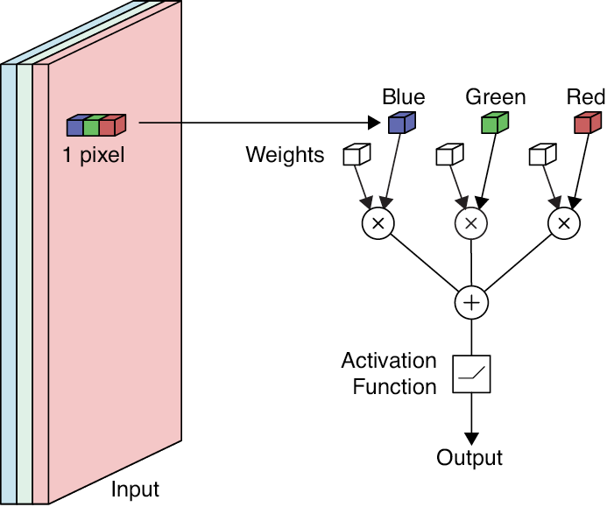
Source: Glassner, A. (2021). Deep learning: A visual approach. San Francisco, CA: No Starch Press. (Chapter 16)
Notes:
Here the neuron from the previous slide has been applied to a single pixel of a color image. Naturally, we can apply this operation to every pixel in the input, creating a single output value for each one. The result is a new tensor with the same width and height as the input, but with just one channel.
=====
Picture of single pixel (3 channels) fed to a single neuron.
Apply operation to every pixel in the image

Slide 22
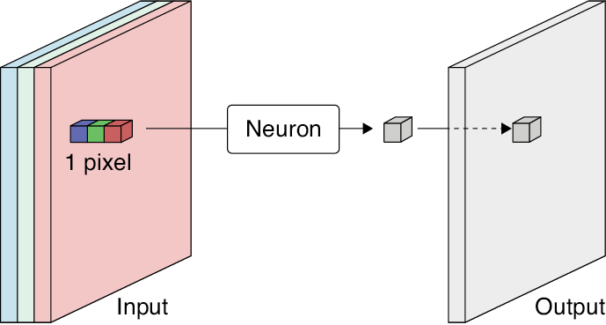
Source: Glassner, A. (2021). Deep learning: A visual approach. San Francisco, CA: No Starch Press. (Chapter 16)
Notes:
And here’s how an algorithm might implement our color to greyscale transformation. First, it applies our neuron to the upper-left pixel, then moves it one step at a time to the right until it reaches the end of the row. It then repeats these steps for the next row, and the next, until it reaches the bottom right pixel. This is called sweeping the neuron over the input or scanning the input.
=====
Start at upper-left – sweep across and down until entire image scanned.

Slide 23
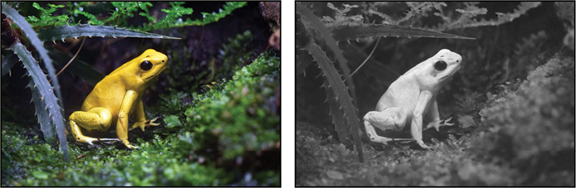
Source: Glassner, A. (2021). Deep learning: A visual approach. San Francisco, CA: No Starch Press. (Chapter 16)
Notes:
Now the results! Here’s what our color to greyscale neuron produced, after scanning an image of a yellow frog to greyscale. As intended, the more yellow an input pixel is, the whiter its corresponding output. In this case, we say that the neuron is identifying or detecting yellow in the input.
Naturally, there’s nothing special about yellow. We can build an artificial neuron to detect any color. When we use a neuron in this way, we say that it’s filtering the input. In this context, the weights are often called filter values or just the filter. The mathematical word is kernel, and that’s the one we’ll use in these briefings.
=====
Concrete example – image of a yellow frog converted to greyscale…
Greyscale output – more yellow a pixel is, the whiter its corresponding output.
Neuron is identifying or detecting yellow.
We say the neurons filter the input.
In ML, filters are called kernels (mathematical term)
Generalizable – neurons to detect any color

Slide 24
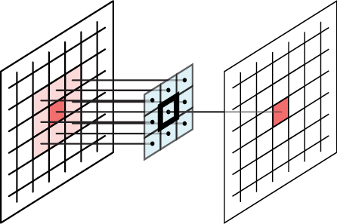
Using larger kernels
Source: Glassner, A. (2021). Deep learning: A visual approach. San Francisco, CA: No Starch Press. (Chapter 16)
Notes:
Here we apply a three-by-three filter to an image by convolving it with that image, sweeping from left to right, top to bottom. For each input pixel, we imagine centering the three-by-three grid of weights over that pixel, applying the neuron, and creating a single output value, as shown here. We say that the pixel we’re centering the filter over is the anchor (or the reference point or zero point). Let’s simulate the convolution operation…
=====
Apply a 3 x 3 filter to an image by convolving it with that image, sweeping left to right, top to bottom
Center the 3 x 3 grid of weights over each pixel and apply the neuron to create a single output.
The underlying pixel at the center of the filter is the anchor, reference point, or zero point.

Slide 25
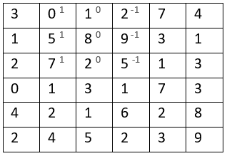
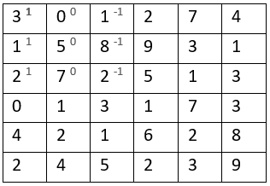
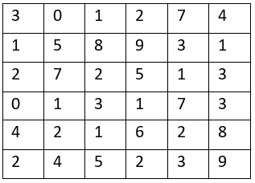
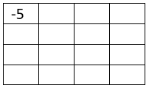
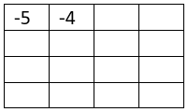
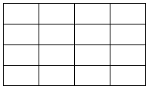
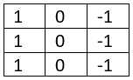
Convolution
Input
Filter or Kernel
Output
*
=
0 x 1 + 5 x 1 + 7 x 1 + 1 x 0 + 8 x 0 + 2 x 0 + 2 x -1 + 9 x -1 + 5 x -1
3 x 1 + 1 x 1 + 2 x 1 + 0 x 0 + 5 x 0 + 7 x 0 + 1 x -1 + 8 x -1 + 2 x -1
Source: https://www.youtube.com/watch?v=XuD4C8vJzEQ
Notes:
We start with an input image, a filter or kernel, and an output tensor waiting to be filled. Note: the asterisk is the mathematical symbol for convolution. Unfortunately – in Python – this is also the multiplication operator.
We apply our filter to the upper left corner of our input – now shaded in light blue. As we can see, the filter’s values appear as superscripts. The convolution operation is simple. Multiply each input value by its corresponding filter value. And then, add everything up to arrive at a single output number – in this case -5. The addition and multiplication is shown.
We then slide the filter / kernel over by 1 and repeat the process. The result this time is a -4, as shown in the output tensor. Keep in mind: the convolution operation sweeps the kernel from left to right, top to bottom. And continues until it reaches the bottom right-hand corner. There are variations we will discuss later.
Let’s simulate this process…

Slide 26

Image Credit: https://cognitivetruth.wordpress.com/2019/02/01/convolutional-neural-networks/
Notes:
… and a simulation of how convolution works on a color image. Here we see 3 kernels – one each for the red, green, and blue channels. As the kernel moves across the underlying input, the two matrices are multiplied. The results of that multiplication are summed, resulting in a single number for each channel. And finally, these three numbers are added together and the result placed in the output matrix.

Slide 27
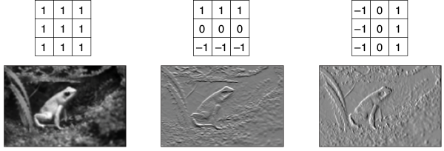
Blurring
Horizontal Edges
Vertical Edges
Source: Glassner, A. (2021). Deep learning: A visual approach. San Francisco, CA: No Starch Press. (Chapter 16)
Notes:
So far, we’ve been sweeping a single neuron over the image, processing one pixel at a time. But sometimes, it’s useful to look at the pixels near the one we’re processing. Usually, we consider a pixel’s eight immediate neighbors. That is, we use the values in a little three by three box centered on a pixel.
This figure shows three different operations we can apply using a three-by-three filter or kernel:
blurring
detecting horizontal edges
… and detecting vertical edges
To compute each image, we center the block of weights over each pixel in turn and multiply each of the nine values under it by the corresponding weight. We add up the results and use their sum as the output value for that pixel. Let’s visualize this operation.

Slide 28
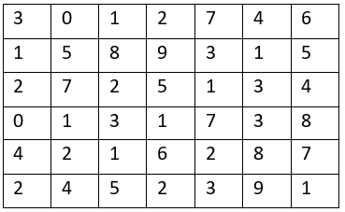
Stride
Stride of 1
Stride of 2
Source: https://www.youtube.com/watch?v=tQYZaDn_kSg
Notes:
Stride is the step size taken by a filter or kernel as it moves across the input data.
Simulation: First click sequence – stride of 1, across and down
With a stride of 1, we start the filter in the upper-left pixel of the input image. The filter produces an output, then takes one step right, produces another output, moves another step right, and so on until it reaches the right edge of that row. Then it moves down one row and back to the left side.
But we don’t have to move in single steps. We can set our stride to be any value. In our second simulation, the stride is set to 2.
Simulation: Second click sequence – stride of 2, across and down

Slide 29
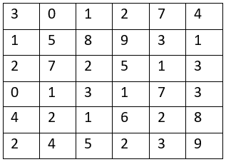
6 x 6
4 x 4
Source: https://www.youtube.com/watch?v=smHa2442Ah4&t=40s
Notes:
However, there’s a minor issue with convolution. When we convolve an image, the output tensor has smaller dimensions than the input.
Let’s simulate the process.
We first apply a filter to our image.
The pixel at the center of the filter becomes the anchor or reference point, pictured.
The filter values are multiplied by the input values (the convolution is executed) and the summed value is inserted into the output tensor.
However, this leads to an output tensor smaller than the original input. We can visualize this by laying the output tensor on top of the input tensor, using the upper-left corner as our anchor point. Here the light grey footprint is smaller by 1 square on all sides.
So, how do we fix this problem?

Slide 30
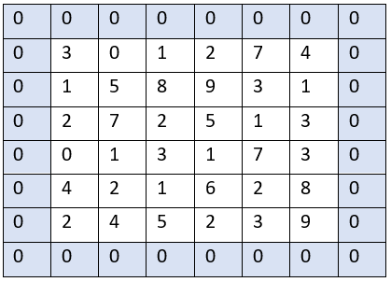
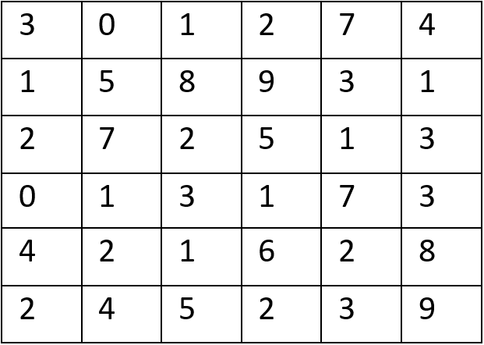
Padding
Source: https://www.youtube.com/watch?v=smHa2442Ah4&t=40s
Notes:
Well, the answer is relatively simple.
We start with an input tensor.
… and simply add a layer of padding around it.
Padding allows us to create an output image of the same width and height as the input. If we place zeros in these cells, it’s called zero-padding. In practice, this is usually done. Or you can mirror the edge pixels in what’s called mirror-padding.
The thickness of the border depends on the size of the filter. We typically use just enough padding so that the filter can be centered on every element of the input. Every filter needs to have its input padded if we don’t want to lose information from the sides.
Most deep learning libraries automatically calculate the necessary amount of padding. We don’t have to worry about it!

Slide 31

Image Credit: https://cognitivetruth.wordpress.com/2019/02/01/convolutional-neural-networks/
Notes:
… and here’s a padding simulation. In this example, the padding layer is 2 pixels deep, resulting in a green output matrix that is larger than the blue input image.

Slide 32
Notes:
Now that we’ve discussed the convolution operation, let’s take a closer look at pooling, starting with max pooling.

Slide 33
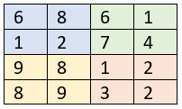
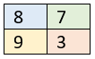
Max Pooling
Input Image
Max pooling with
Stride 2
Result
MAX
MAX
MAX
Source: https://www.youtube.com/watch?v=8oOgPUO-TBY&t=6s
Notes:
The pooling layers reduce the dimensions of the feature maps created by convolution layers, in a process called down sampling. But why do we do this? First, we do it to reduce the number of calculations a network must perform. This speeds up the training process. Second, down sampling eliminates some of the noise in the feature map. It helps the model detect underlying patterns.
A pooling operation acts like a filter. But rather than performing a convolution operation, it uses an aggregation function such as average or max. Let’s simulate this process.
The max filter is applied and the largest number in the input matrix is added to the output tensor. The result is 8 in the blue cell.
In this example, our stride is two and the max pooling operation is once again applied. The result is 7 in the green cell.

Slide 34

Max Pooling
Image Credit: https://cognitivetruth.wordpress.com/2019/02/01/convolutional-neural-networks/
Notes:
Simulation of max pooling with a stride of 2.

Slide 35
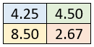
Average Pooling
Input Image
Max pooling with
Stride 2
Result
AVG
AVG
AVG
Source: https://www.youtube.com/watch?v=8oOgPUO-TBY&t=6s
Notes:
Max pooling is not the only option available. We can also do average pooling.
As in the previous simulation, we apply the filter, take the average of the 4 cells and update the output tensor.
Once again, our stride is two and the average pooling operation is applied, resulting in 4.50 as the output (indicated in green)

Slide 36
Notes:
Now, before I conclude – we need to take a closer look at that last fully connected layer, specifically its output in relation to its activation function. Indeed, the activation function you select will vary, depending on what the network is designed to do.
=====
Focus on last fully connected layer – specifically output in relation to activation function.
For that last layer, activation function will vary, depending on desired final output.

Slide 37
Problem Type | Activation Function for Last Layer | Output
Regression | None (or identity function) | A numerical number that can take any value
Binary classification | sigmoid | A numerical number ranging from 0 to 1 corresponding to the probability of the observation.
Multi-class classification | softmax | Multiple numerical numbers (depending on the number of classes) ranging from 0 to 1 corresponding to the probability of each class.
Notes:
CNNs are widely used to classify images. A simple model capable of classifying dogs and cats is called a binary classifier. Whereas a model capable of recognizing 20 different kinds of fruit is called a multi-class classifier.
To make predictions, the last layer of a CNN needs to be fully connected and use an activation function suitable to the prediction task. Here we see a list of recommended activation functions, one for each problem type – regression, binary classification, and multi-class classification. With regression, the activation function is usually linear. With binary classification, it’s sigmoid. And with multi-class classification, it’s softmax – an activation function that calculates a probability for each class, with all the probabilities summing to one.
=====
CNNs are frequently used for image classification – two types:
Binary – 2 classes – ex. dogs vs. cats
Multi-class – > 2 classes – ex. 20 different kinds of fruits
For predictions, last layer fully connected w/appropriate activation function
Regression: activation function is usually linear
Binary: activation is sigmoid – you’ll see this in our next exercise
Multi-class: activation is softmax – calculates the probability for each class, with all those probabilities summing to one

